Slide 1

Neeraj Waman Chavan
Digital Analyst
Performance Highlights

Slide 2
Campaign Highlights – Performics India
Campaign | Period | Organic Traffic
Hotstar (OTT) | April 18’ – June 18’ | 99.8M
IPL | April 7th - May 27th (2018) | 43.1M
Republic World(News & Media) | August 18’ – March 19’ | 12.3M
Key Highlights -
Achieved around 100M organic sessions from April 2017 to June 2017 for Hotstar
Performed real time search optimization during IPL 2018 leading to around 43.1M organic sessions in approximately a month
Carried out off-page link building activities and syndicated content through relevant platforms and blogs
Got Republic World’s included as a News publisher into Google News in September 2018 thereby increasing searc visibility and website traffic by 47% in 8 months.

Slide 3
Key Highlights - Hotstar
Handled SEO and Performance Content activities for India’s Largest OTT Platform
Real time search optimization of sporting events like IPL and EPL
Carrying out off-page and link building activities on blogging platforms. (e.g Wiki of Thrones)
Suggesting On-Page Content Recommendations (Meta titles, descriptions, internal linking) for every new show and movie that got updated on the platform
App Store Optimization on Playstore and AppStore

Slide 4
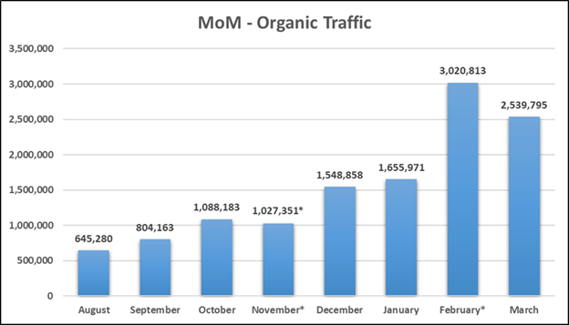
Key Highlights – Republic World
Handled the overall Performance Content and SEO for a major News and Media publishing house in India
Delivered results in a fast-paced and dynamic start-up environment
Suggesting On-Page Content Recommendations for every article that gets written on the website
Suggested implementation of Google AMP to the client which lead to increased visibility of stories in SERPs and thereby improving the traffic by leaps and bounds
Capitalizing on daily entertainment, sports and content trends and then advising the content team to create relevant quality content around it by using proper keywords
*Organic traffic in November was affected by the indexing bug of Google News
*Spike in Feb can be attributed to an event-based traffic in India for which the client was able to dominate organic search visibility

Slide 5
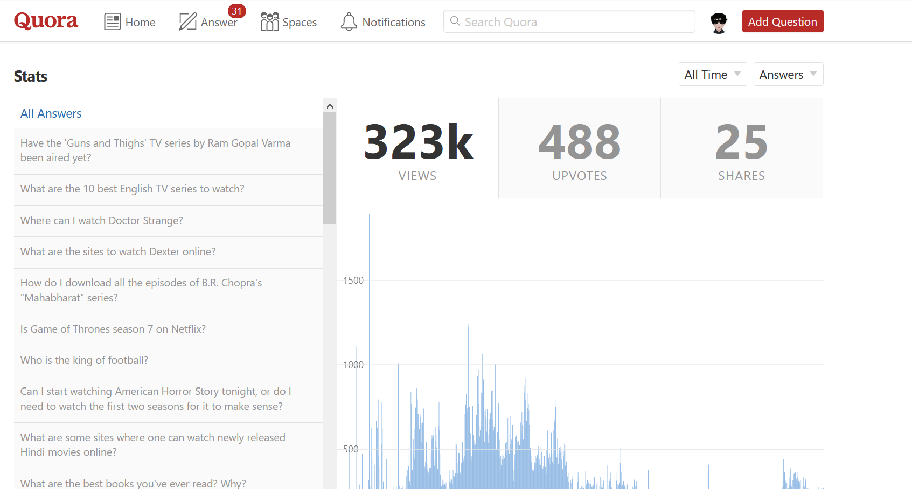
Miscellaneous Highlights
Key Activities -
Written quality off-page content on Quora for Hotstar as well as Republic and generated a healthy back-link profile for the same
Performed Technical Audits for websites and then helped in pitching them overall search marketing solutions
Developing user-oriented content optimization solutions for the clients in real time
Expertise in utilizing Google Analytics and Google Search Console to derive insights for solving client problems and for tracking daily consumer data (Creating Custom Reports, Custom Dashboards etc.)
Conducted knowledge sharing sessions on recent developments in the world of SEO, Digital Marketing and Data Analytics

Slide 6



THANK YOU!
Neeraj Chavan – https://www.linkedin.com/in/neeraj-chavan/
ncneerajchavan@gmail.com
+353 0894038920

